Slide 1


Torohia
Stakeholder presentation

Slide 2

What is Torohia?
Torohia is the Medical Council’s annual online survey for doctors across Aotearoa New Zealand
– to feed back on their education and training experiences.
Timing
Open for 4 weeks in August/ September each year.
Participation
Doctors in prevocational and vocational training programmes, and general scope doctors not in accredited medical training.
Confidentiality
Survey is confidential and guarantees
anonymity of participants.
Results
Reports are published in January/ February
each year, and on the website dashboard.
Notes:
Note: The name Torohia means ‘exploring, scouting out, reaching out’, which is what this survey sets out to do — exploring the training environment, identifying strengths, and highlighting areas for improvement.

Slide 3
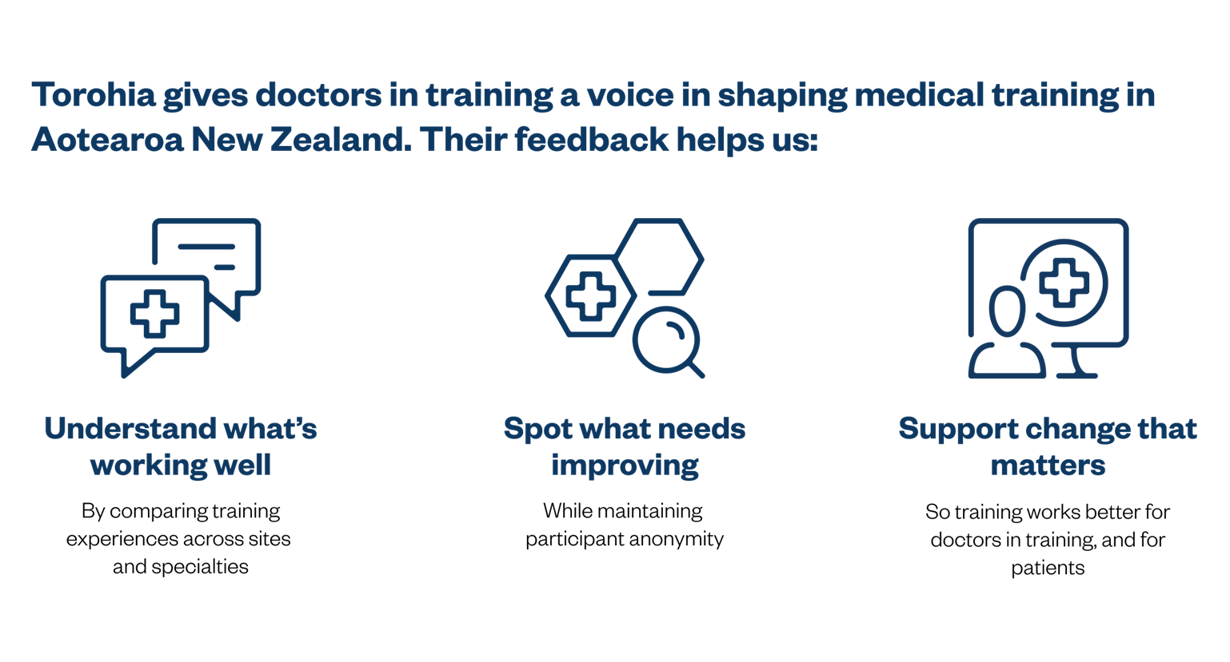
Purpose of Torohia
Torohia gives doctors a voice in shaping medical training in Aotearoa New Zealand. Your feedback helps us:
Notes:
Survey results will be published each year, and will be used to:
*Better understand participating doctors’ experiences of medical education and training.
*Support training providers and employers to make continuous improvements.
*Inform accreditation processes run by the Medical Council of New Zealand and the Australian Medical Council.

Slide 4
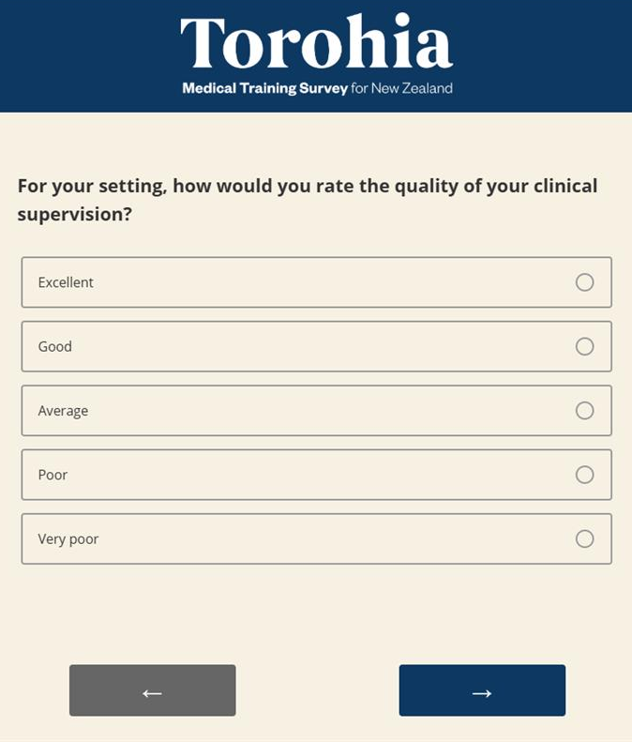
Topics
Orientation
Training curriculum
Clinical supervision/ support
Developing skills and knowledge
Access to teaching
Assessment
Workplace environment and culture
Patient safety
Overall satisfaction with training
Future career intentions
Notes:
Survey has approximately 60 questions and takes around 20 minutes to complete

Slide 5
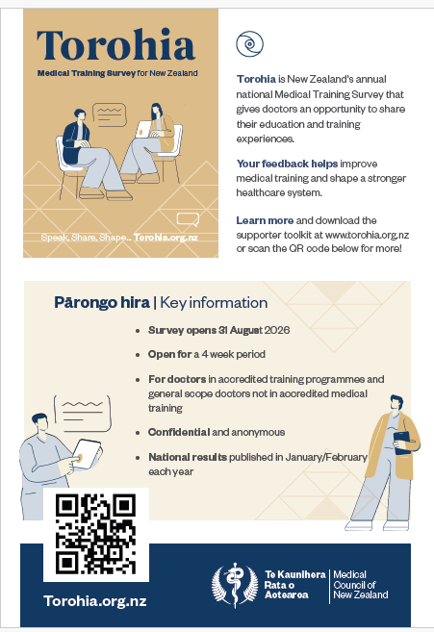
Visit Torohia.org.nz to find:
Key information
How Torohia was developed
Detailed FAQs for participants
Privacy statement
Promotional toolkit
Results

Slide 6



