Slide 1


Introducing Torohia
Stakeholder presentation

Slide 2
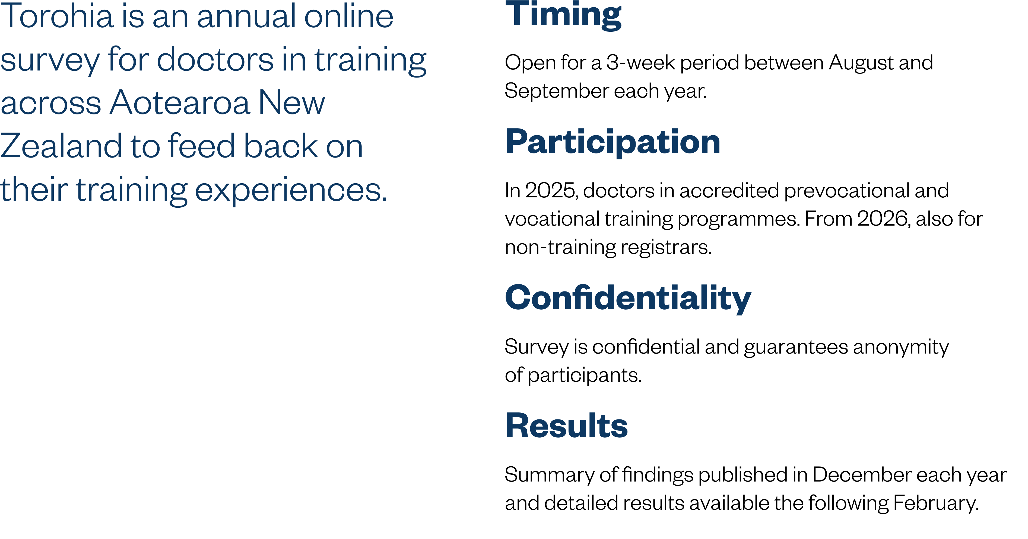

What is Torohia?
Notes:
Note: The name Torohia means ‘exploring, scouting out, reaching out’, which is what this survey sets out to do — exploring the training environment, identifying strengths, and highlighting areas for improvement.

Slide 3
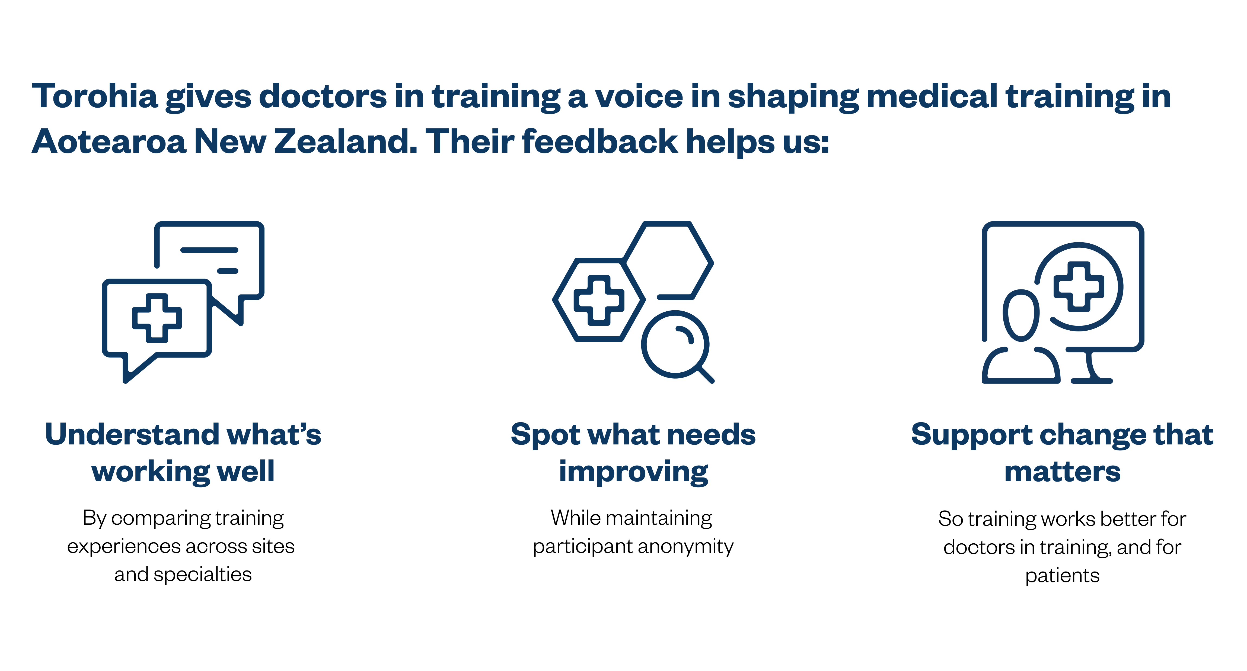
Purpose of Torohia
Notes:
Survey results will be published each year, and will be used to:
Better understand the experience for prevocational and vocational trainees in the medical training environment
Support continuous improvement for training providers and employers
Inform accreditation processes that are run by Te Kaunihera Rata o Aotearoa | Medical Council of New Zealand (Council) and the Australian Medical Council (AMC).

Slide 4
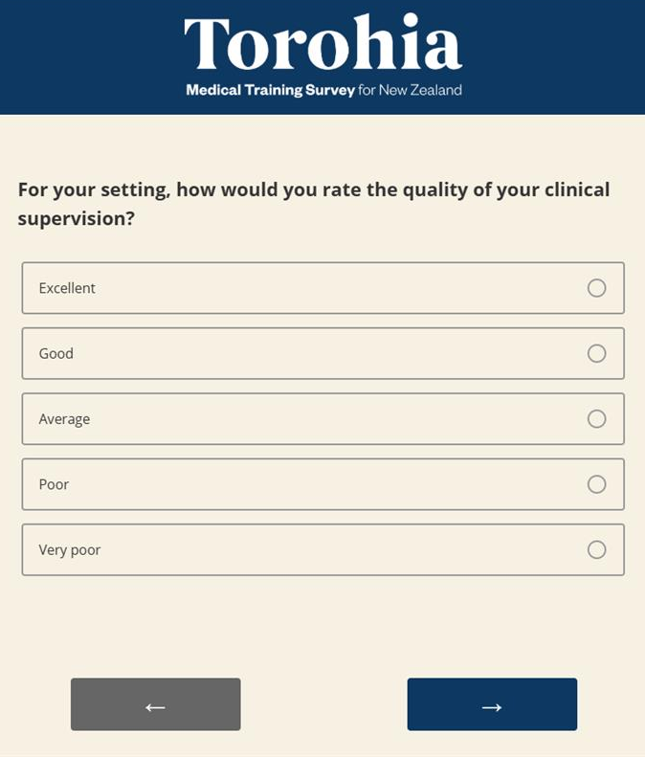
Topics
Orientation
Training curriculum
Assessment
Clinical supervision
Access to teaching
Workplace environment and culture
Patient safety
Overall satisfaction and fulfilment
Future career intentions
Notes:
Survey has approximately 60 questions and takes around 20 minutes to complete

Slide 5
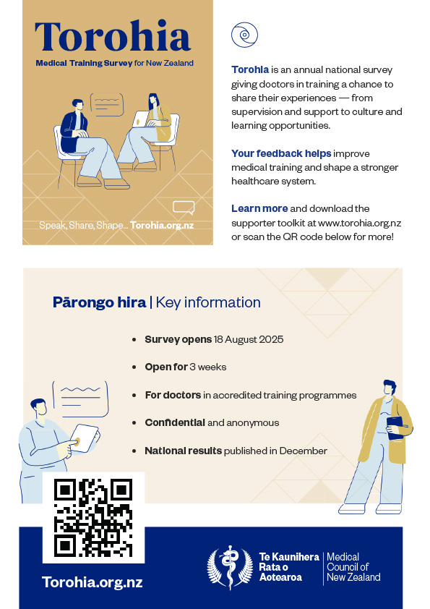
Visit Torohia.org.nz to find:
Key information
How Torohia was developed
Detailed FAQs for participants
Privacy statement
Promotional toolkit
Results (as of December 2025)

Slide 6



